Slide 1
MTC Supply Chain Optimization Strategies
- By Vaidyanathan V (July 2022)

Slide 2
Introduction & Overview
Based in: Collegeville, PA, United States
Services Offered by MTC: Health care and medical products for hospital surgeons (Medical Surgical Kits & Other Special Kits)
Chief Supply Chain Officer: Chris Evert
Problem Statement: New imposed “Affordable Care Act (ACA)” with a 2.3% Medical Excise Tax in Annual Revenue
Challenges Faced: 10% decrease in annual gross profits, cost reduction and savings by changing and implementing a new supply chain process
About Myself:
Supply chain enthusiast, a key team player, always ready to tackle new challenges
Looking for a career change in the world of Supply Chain Management

Slide 3
Executive Summary of MTC’s Current Situation
1. Current Logistics Network in MTC:
The current logistics network will have to be managed by implementing the lean six sigma (DMAIC) approach.
Due to JIT (just in time) production system, the step from “sterilization process→ to the assembly unit” will be reduced by 2 days (48 hrs) & additional transportation costs goes down.
The current “Trunk Stock” i.e. the holding of inventory by the sales reps in their cars will be minimized for the 80% medical surgical kits and also removing the process of re-sterilization.
The local warehouse storage centers that MTC should implement building closer to the hospitals will help in avoiding in additional transportation and storage costs.
Contracts can be issued and relationships can be established by outsourcing to any 3rd party (3PL) warehouse facility also keeping in consideration the distance to the hospitals and to save re-sterilization and holding costs.

Slide 4
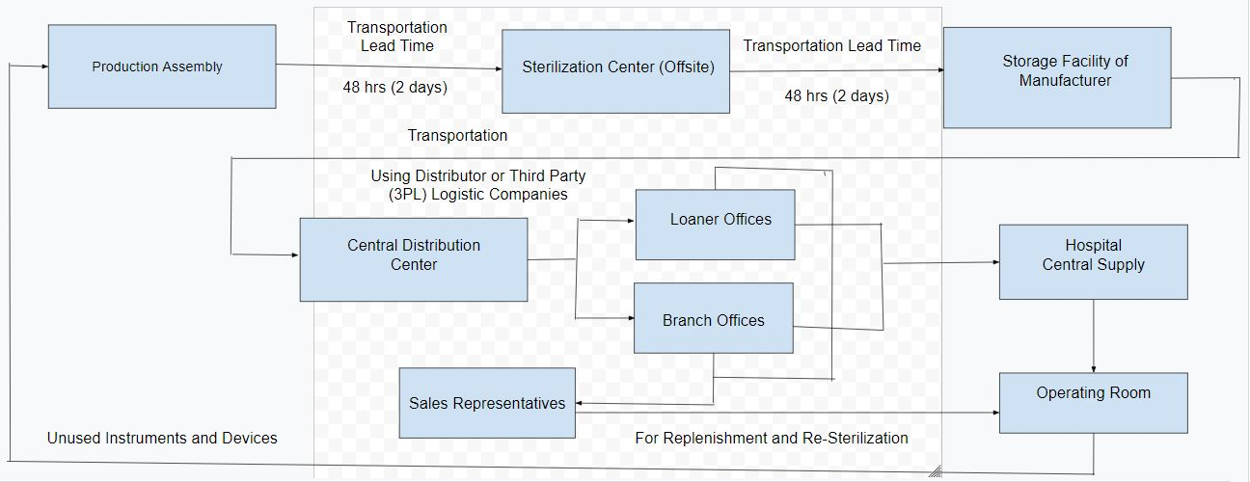
MTC’s Current Outbound Logistics Flow Diagram

Slide 5
Executive Summary (Contd.)
2. Inventory Management At MTC
The lean six sigma process can be implemented in the MTC’s inventory management by using the “Kanban” system (with 3 bins each at the manufacturing unit, sterilization center and at the hospital operating rooms).
The “sS” method which is (continuous review system with variable reorder quantity) can ensure there is low inventory holding costs and a responsive manufacturing process.
Opportunity costs and also paying commissions and incentives can be generated so that it will benefit the employees of MTC’s third party logistics supplier company.
By using different forecasting techniques for planning (Exponential Smoothing & Moving Average), we can calculate the average MSE which will allow for a more analytical prediction of demand and forecasting.
The sales reps can be instead utilized at the hospitals where they should conduct necessary trainings for the hospital staff, finance departments, surgeons on the new innovative technologies and not used in holding inventory stock of the MTC.

Slide 6
Demand Forecast Prediction Analysis for MTC

Slide 7
Executive Summary (Contd.)
3. Sourcing & Sales At MTC
MTC maintains its core capabilities and outsourcing activities with 3rd party (3PL) logistics provider companies who have a stronger capacity and storage in order to not increase any sort of additional investments.
This entails the off-site sterilization process which MTC currently has and also its sales reps.
Short term contracts of an external service provider for sale can ensure better predictive and competitive prices compared to dependencies on direct contract of sales.
An additional focus on selling to regionally established hospital groups will save lot of time and energy.
The cost of single hospital contracts usually comes with a long term provision and consequently sells larger volumes.

Slide 8
Improvement Areas For MTC
“In a recent New York Times article, it was reported that 3D printed limbs can not only provide customized solutions to patients and doctors, but it can provide them at a much lower cost than traditional prosthetics
SOURCE: MTC SUPPLYCHAINCASESTUDY, P.7”
The proposals which I have highlighted in the previous slides focuses on implementing fast result changes while also maintaining competitive strengths (which includes outsourcing parts of the supply chain). The particular areas that need to be improvised at MTC are negotiation of new contracts, creation of excel files for accurate updates of sales for demand prediction, time based opportunity costs, and re-routing of the logistics process resulting in large and stable savings in the long run.
The MTC should also observe. Analyze and take corrective measures of the current marker trend and become an early investor for change and generating a competitive advantage.
The MTC should also try to be a valuable provider to the hospitals since by implementing technologies like 3D printing, there will be very high investment costs and MTC has to look out for a partner who can research and manage the development and infrastructure plans.

Slide 9
Risk Assessment & Mitigation At MTC
1. Investment Failure
Investing in the 3D printing technology for R&D does not get actual result or success. There will also be other players in the market who could be faster, more successful and innovative which will leave behind MTC’s investment plan unrecognized.
Risk Prevention:
The possible risks involved here such an investment can also be considered as “Sunk Cost” and for that an alliance or a partner should be strategically brought on board.
Approaching a large corporate might come at lower interest rates due to decrease in negotiation power but should somehow manage to get accepted due to reputational gain and long term market positioning.

Slide 10
Risk Assessment & Mitigation (Contd.)
2. Non-Critical Supplier
Being a non-critical supplier will be challenging in a market that is continuously consolidating and internationalizing.
Innovation investment implies to the definition of the “Kraljic Matrix” to become a strategic supplier which will prove to be crucial for MTC’s success.
Risk Prevention:
No postponement of innovation related investments, maintaining the level of negotiation with the hospitals, focus on high quality techniques (Eg: off-site sterilization, well qualified and trained sales reps).
Focusing on long term partnerships with the hospital groups under provision of good quality service levels.

Slide 11
Risk Assessment & Mitigation (Contd.)
3. General Risks
The cost advantage of the large surgical kit manufacturers (economies of scale) and the possibility of tax avoidance through international placements by competitors would result in a big threat to MTC’s competitiveness.
Shifts in demand could be underrepresented in this case due to the immediate focus on the supply chain imposed by MTC’s board of members.
Risk Prevention:
The thorough analysis of MTC’s corporate and international strategies is inevitable.
A distinct strategic focus on high quality and product provision can help the MTC to avoid a broad market competition.

Slide 12
Conclusion Results
The MTC should analyze all of their LOPS strategy and come up with a formidable, well organized and structured supply chain plan if they want to keep their annual profits maintained.
The relationships and maintaining the business with their 3PL logistics providers and the hospital groups will be crucial for them.
But they should keep an eye and keep on analyzing the market trend and at anytime be ready to bring and implement a change in their process in order to survive in the market.
I feel confident that MTC will succeed in their innovation plan and make up for their 10% profit loss due to the excise tax of 2.3%.

Slide 13
Q&A
Thank You!!!!

